Slide 1

Blazor, running .NET apps in the browser
Blazor a framework for building interactive client-side web UI with .NET

Slide 2

HELLO!
I am Linda Lawton
25+ years of backend development experience.
You can find me at @LindaLawtonDk
www.Daimto.com

Slide 3

SERVER SIDE
Show and explain your web, app or software projects using these gadget templates.
Notes:
If you wanted to use .net framework you were only able to use this server side. A long with other languages like go, java and node.js. But what if you wanted to code C# on the client isde.

Slide 4
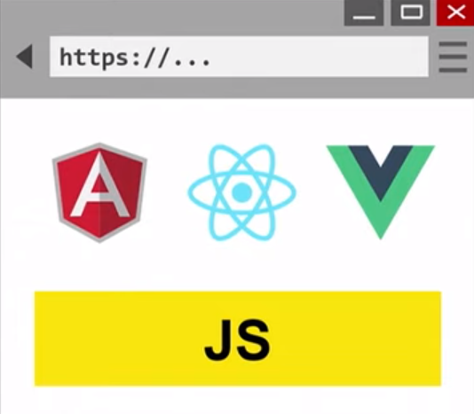
Place your screenshot here
CLIENT SIDE
JavaScript had a monopoly on client side (angular, react ..)
Notes:
Preivously if you wanted to work with client sided you needed to use javascript or a javascript framework like angular react or others.

Slide 5
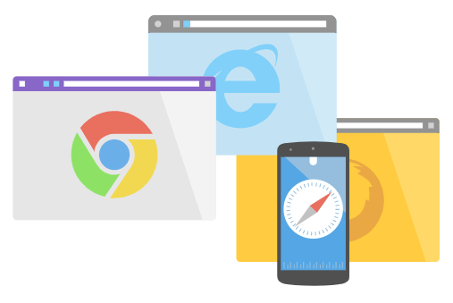
Place your screenshot here
Built on open web standards
Blazor uses open web standards without plugins or code transpilation. Blazor works in all modern web browsers, including mobile browsers.
Notes:
Blazor uses open web standards without plugins or code transpilation. Blazor works in all modern web browsers, including mobile browsers.
Code running in the browser executes in the same security sandbox as JavaScript frameworks. Blazor code executing on the server has the flexibility to do anything you would normally do on the server, such as connecting directly to a database.

Slide 6
How does blazor look
1.
Show me the code.

Slide 7
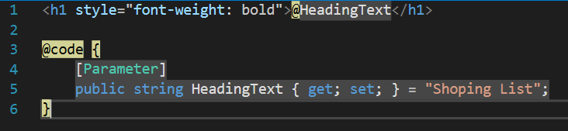
It’s all about components
A component is a self-contained chunk of user interface (UI), such as a page, dialog, or form.
Notes:
Blazor is component based. Components can be as small as a single html tag. Note the paramater attribute which will allow me to pass a value of the heading from the parent. I could also have created a another paramater with say font style. Allowing the developer to supply a style as well when calling however the faunt weight would remain bold by default unless over ridden

Slide 8
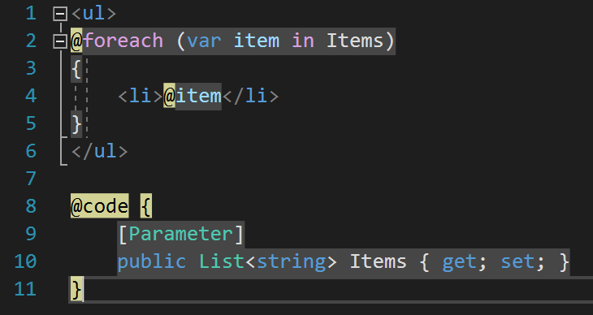
C# code mixed with HTML
In the @code block, component state (properties, fields) is specified with methods for event handling or for defining other component logic.
Notes:
The code block is where your C# code goes. However notice how i can use a C# for loop inline within my html code by adding a @ to the beginning

Slide 9
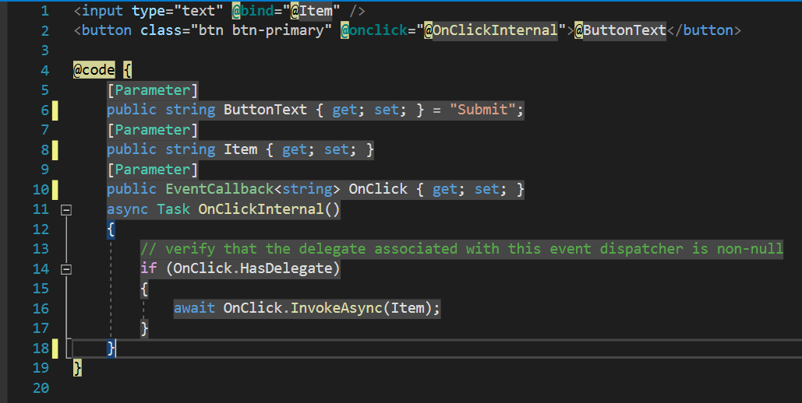
EventCallBack from child to parent
Events
You can define your events in the child and have the event sent back to the parent for handling.
Notes:
I found event callbacks quite exciting. Here we have a simple html button and a input field taking some text.
The onclick property has a parameter value attached to it meaning that it can be assigned from the parent.

Slide 10
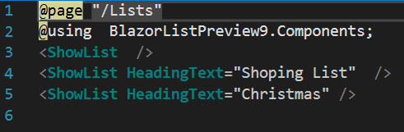
Components are reusable
Due to the fact that everything is component based. It makes for simple reusability of your code.
By creating once Show List component and simply sending a different heading I can have three separate lists displayed using the sample code.
Notes:
Components are completely reusable. By simply swapping out the heading text i now have three lists for the code prices of one.

Slide 11
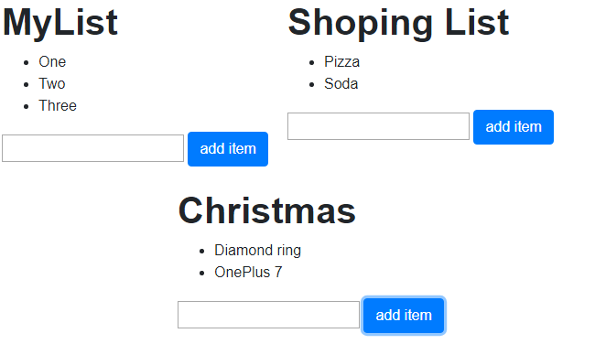
Three lists for the price of one
Notes:
Each of these components is its own entity if you will.

Slide 12
Sharing is caring
Publish to NuGet
Because component libraries are standard .NET libraries, packaging and shipping them to NuGet is no different from packaging and shipping any library to NuGet.
>Dotnet pack
>dotnet nuget publish
Notes:
Whats really nice about things being component based. Is the ablity to share them. They can be packged into nuget packges just like a .net librarry and you can share them with your team and other developers if you wish by publising them to nuget.org

Slide 13
So what's really going on?
2.
Its client side.

Slide 14
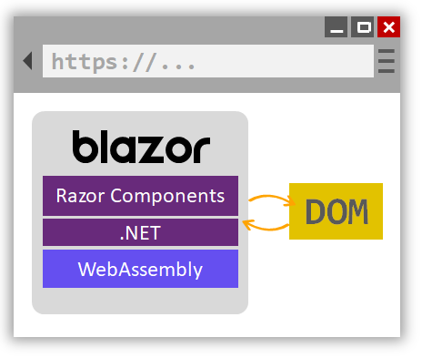
Blazor WebAssembly app is built and run in a browser
Behind the scenes
C# code files and Razor files are compiled into .NET assemblies.
The assemblies and the .NET runtime are downloaded to the browser.
Blazor WebAssembly bootstraps the .NET runtime and configures the runtime to load the assemblies for the app. The Blazor WebAssembly runtime uses JavaScript interop to handle DOM manipulation and browser API calls.
Notes:
Wasm is designed as a portable target for compilation of high-level languages like C#, enabling deployment on the web for client and server applications.
Mono is a software platform designed to allow developers to easily create cross platform applications (mono runtime compiled to web assembly)
The component class is usually written in the form of a Razor markup page with a .razor file extension.

Slide 15
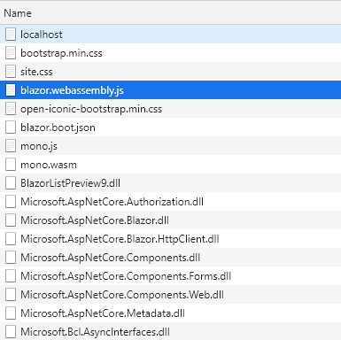
Loading .net dlls in the browser.
Chrome debug
If you disable cache in Chrome deuber and check the network tab you can see exactly whats going on.
Blazor.webassembly.js is a small chunk of javascript that knows how to load Mono.
Mono.wasm is the mono web assembly runtime starting up.
All your dlls then load.

Slide 16
Space
Currently 2.5 mb of .net dlls are loaded.

Slide 17
Trying blazor
What you need to run Blazor:
.net core 3.0 sdk latest and greatest
Visual Studio 2019 Preview
dotnet new -i Microsoft.AspNetCore.Blazor.Templates::3.0.0-preview9.19424.4
Find Help here:
https://docs.microsoft.com/en-us/aspnet/core/blazor/
https://stackoverflow.com/questions/tagged/blazor

Slide 18
Where to find me
Linda Lawton:
Twitter: @LindaLawtonDk
GitHub: https://github.com/LindaLawton
Blog: https://daimto.com
Find Help here:
https://docs.microsoft.com/en-us/aspnet/core/blazor/
https://stackoverflow.com/questions/tagged/blazor

